Slide 1

The Silent Burden of Heart Disease in Young America
A data-driven investigation into an overlooked condition where cardiomyopathy silently causes premature deaths among young people, demanding immediate attention.
Project by: Madan Timilsina
Completed on: 23 August, 2026

Slide 2
“The death of one person is a tragedy; the death of millions is a statistic.”
— Joseph Stalin

Slide 3

Objectives
RESEARCH QUESTION
CORE OBJECTIVE
How does cardiomyopathy quietly drive mortality rates among America's youth compared to broader heart disease trends?
To challenge the prevailing assumption that heart disease is strictly an older adult's affliction.

Slide 4
Study Parameters
Timeframe: 2018 - 2024
Target age: 0 – 44
Data Focus: The broad NCHS "Diseases of Heart" category with most common heart disease (Cardiomyopathy, Heart Failure, Chronic Ischemic heart disease, and heart attack) to subcategory Cardiomyopathy.
Geography: US 50 states + Washington DC
Sex: Male and Female (by birth)
Race (experimental): Black, White, American Indian and Alaskan Native, Asian (Chinese, Japanese, Korean, Vietnamese, Filipino, Asian Indian, Other Asian), Pacific Islanders (Hawaiian, Samoan, Guamanian or Chamorro, Other Pacific Islander), Other / multi racial

Slide 5

Data Architecture & Methodology

Slide 6
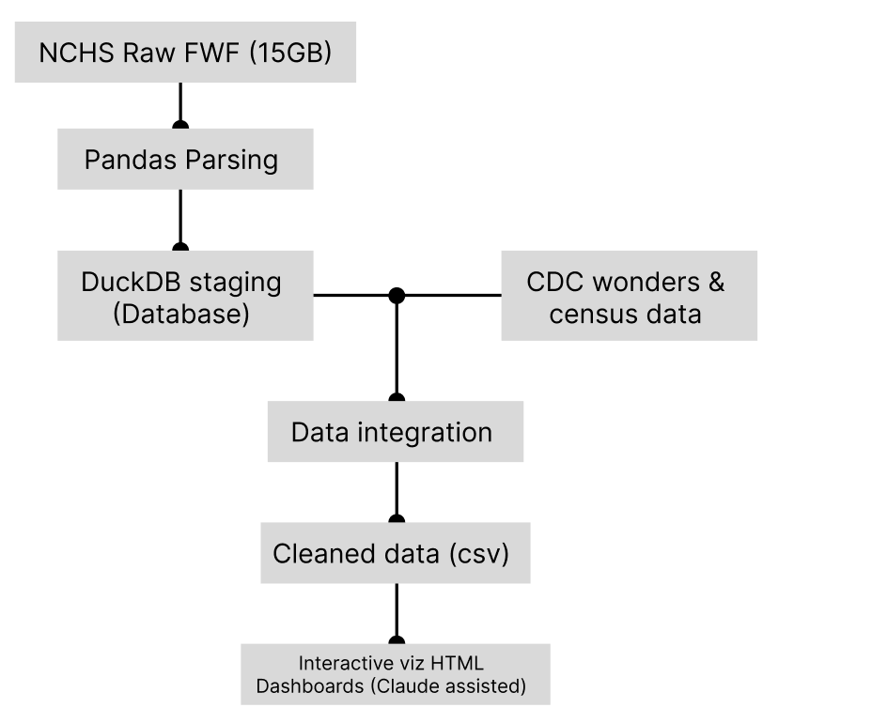
Data Pipeline Architecture

Slide 7
Methodology
Analyze longitudinal mortality trends across four major heart diseases, with a specific, deep-dive focus on Cardiomyopathy impacts within young populations (ages 0-44).
Aggregated and parsed 22,043,274 total mortality records spanning a 7-year timeline (2018–2024).
Tracked 4,774,283 deaths attributed broadly to heart disease (Cardiomyopathy, heart failure, chronic ischemic disease, and heart attack).
Isolated 139,810 deaths driven specifically by Cardiomyopathy for targeted demographic and geospatial modeling.
Detected and corrected a structural shift in the raw data starting in 2021 where the tape location for the "Race" column moved from positions 445-446 to 489-490.
Translated coded values (ICD-10, demographics) into human-readable text to prepare the dataset for visualization.

Slide 8
Visualization & Deliverables Engine
Dashboard Output | Visualization Type | Key Insight & Focus
all_state_all_HeartDiease_all_age | Time-Series Heatmap | Geographic distribution of all 4 heart diseases across all 50 states + DC (2018-2024).
all_heart_disease_all_age | Stacked & Line Charts | Cardiomyopathy dominates younger populations (~60% of cases) but fades as a primary cause in older demographics.
i42_by_state_adults_only | Time-Series Heatmap | Geographic hot-spots isolating Cardiomyopathy deaths specifically in the 0-44 age bracket.
sex_and_seasonal_spike_chart_i42_adults_only | Temporal Line Charts | Male vs. Female death disparities and month-to-month (Jan-Dec) mortality spikes in young populations.

Slide 9
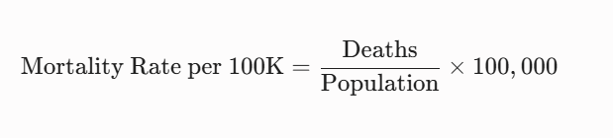
Why Rates, Not Just Counts
100 deaths in a city of 1,000 is a crisis. 100 deaths in a city of 1,000,000 is a footnote. Raw counts mislead. Mortality rates reveals true burden
Numerator
CDC NCHS microdata. Individual death records by ICD-10 code
Denominator
U.S. Census Bureau population estimates by state, age, race, and sex

Slide 10
Why this matters?
What the data reveals

Slide 11
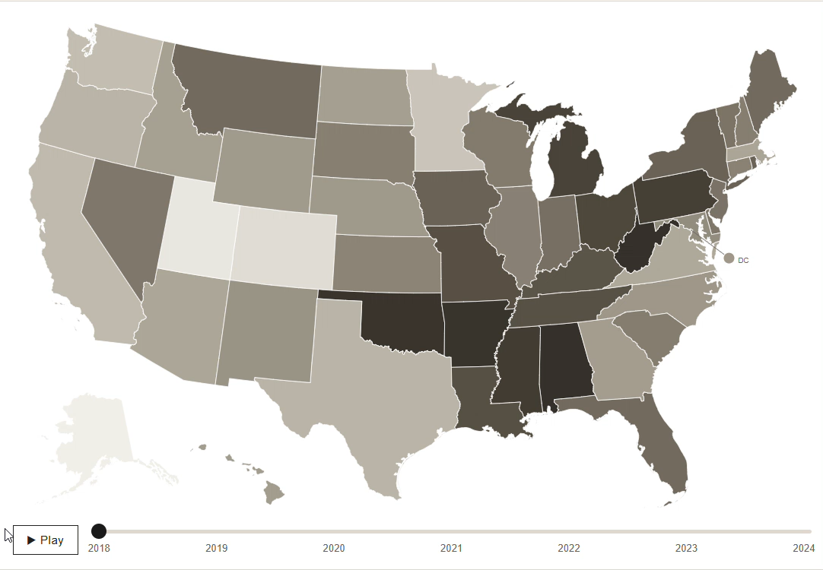
Heart Disease Affects Every Corner of the Nation
Includes death from the most common forms of heart diseases (Cardiomyopathy, Chronic Ischemic heart disease, Heart Failure and Heart Attack)
Data on aggregated scale:
National Average: 205.3 per 100k
Highest: West Virgina (294.6)
Lowest: Alaska (123.5)
Total death: 4,774,283

Slide 12
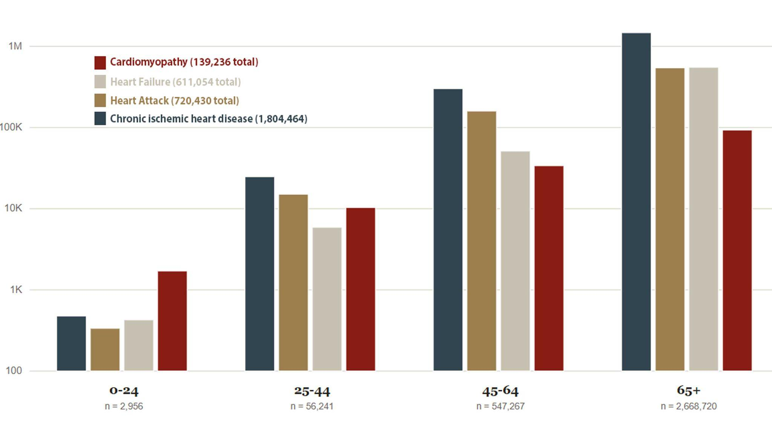
Heart Disease Doesn't Wait for Old Age
While most heart disease rise with age, Cardiomyopathy claims a large share of death in children and young adults before fading into older age groups

Slide 13
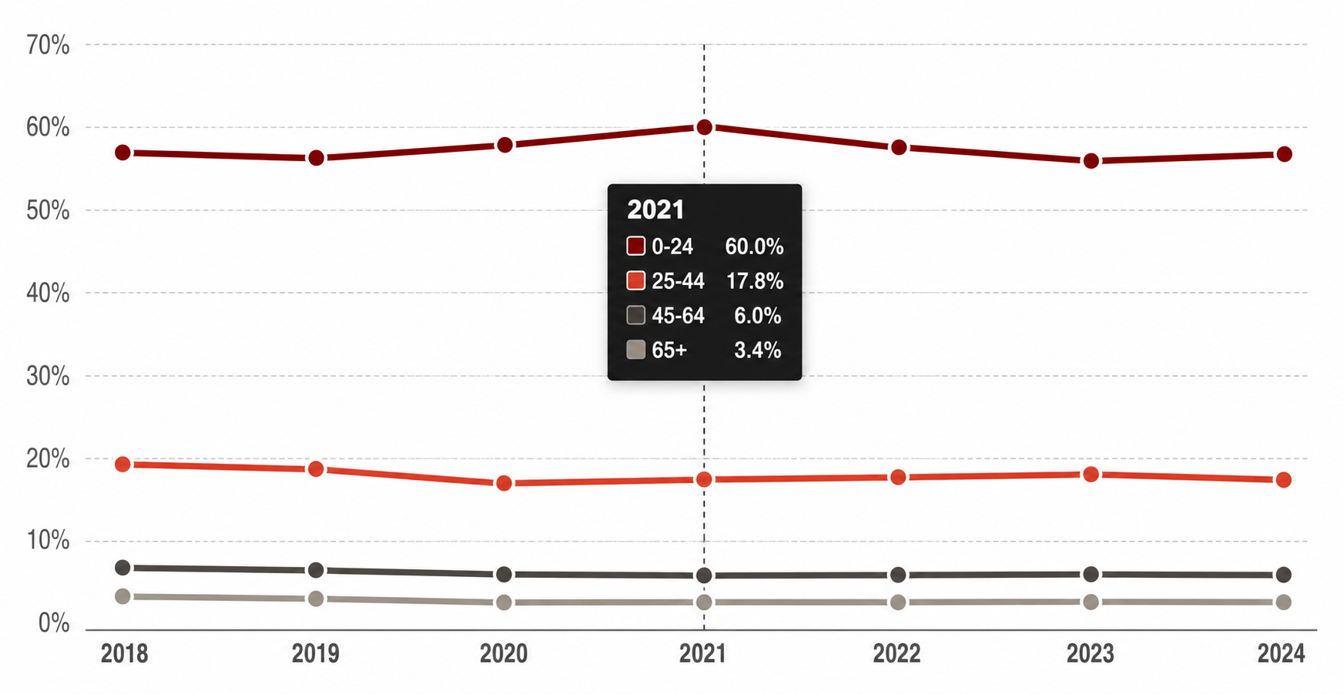
The pattern holds in every single year
Of 4.77M heart disease deaths, Cardiomyopathy dominates the 0-24 age groups with approx. 60% of death every single year

Slide 14
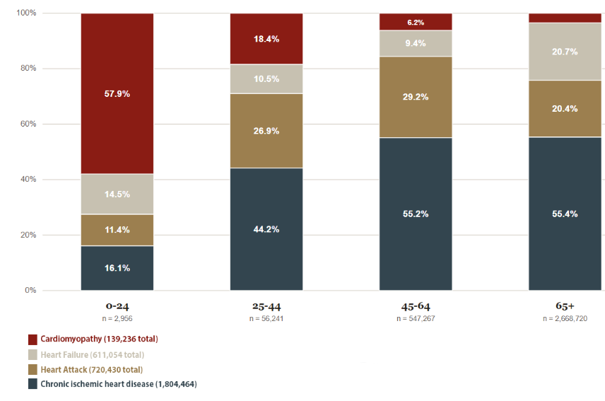
Youth Is Defined by Cardiomyopathy
Cardiomyopathy dominates the Youngest heart but its share is rapidly declined with age and ultimately replaced by Chronic Ischemic heart disease and Heart attack

Slide 15
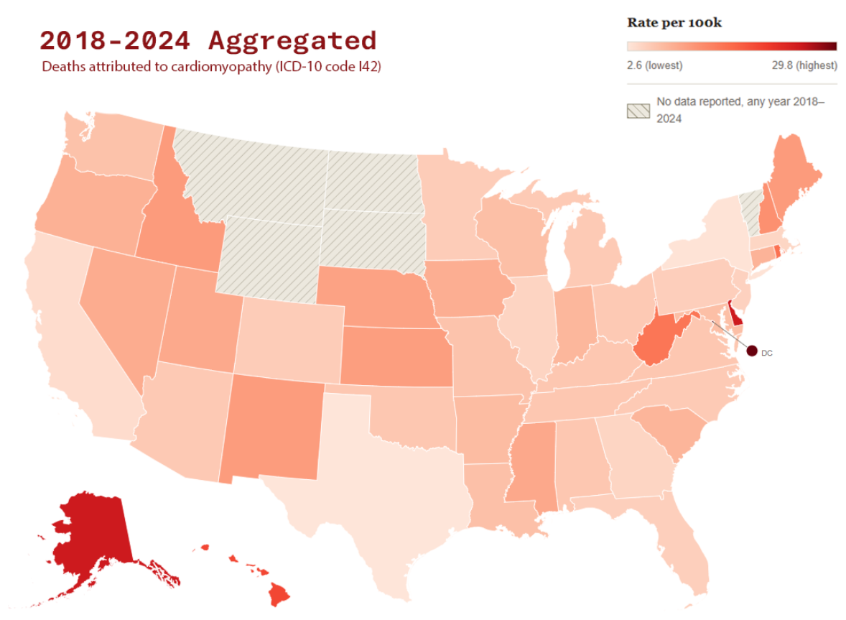
A Silent Burden Across the Nation
Cardiomyopathy is spread across the nation with national average of 4.5 per 100k. Washington DC with highest rate of 29.8 and Texas with lowest of 2.6.

Slide 16
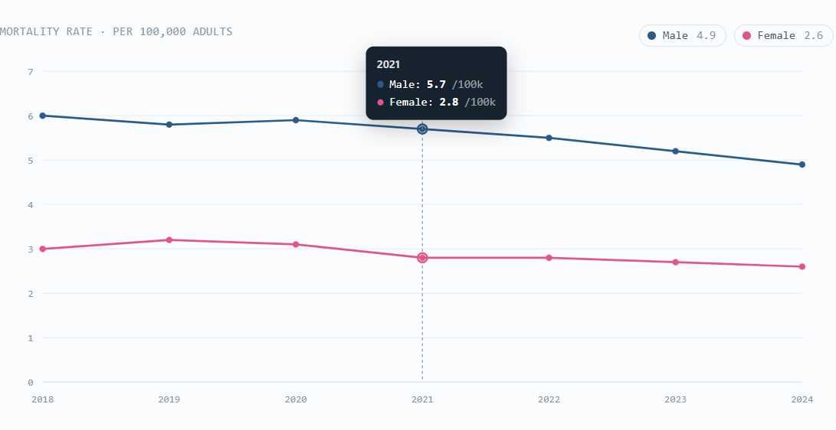
Men Bear Double the Mortality Burden
Approx 2.1x Avg Male to Female ratio
The male mortality rate fell from 6.4 to 5.3 per 100k (−17.2%) between 2018 and 2024. The female rate fell more modestly, from 3.0 to 2.6 per 100k (−13.3%), holding the gap between the two lines roughly constant across the period.

Slide 17
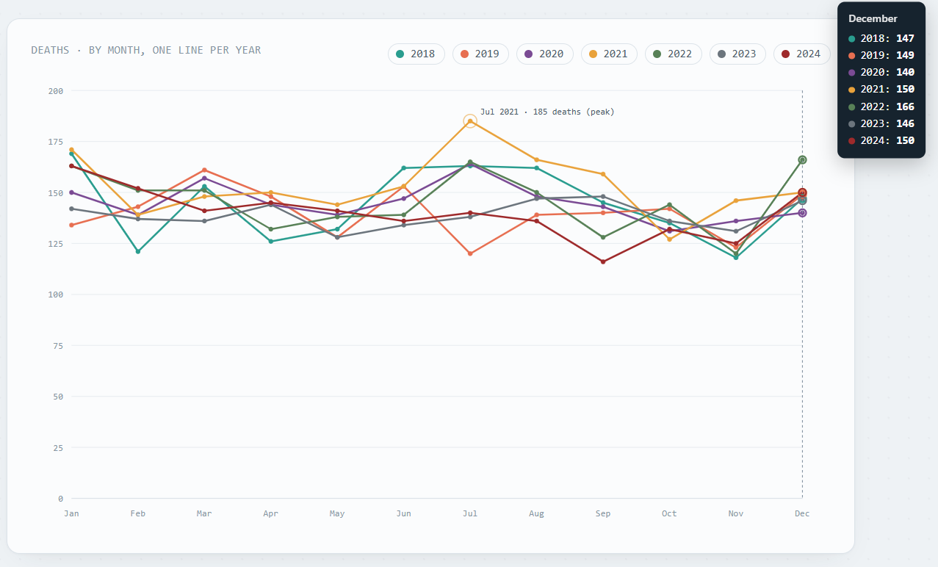
January is the peak month
Averaged across all seven years, January is the highest mortality month with sharp increase from November
The single largest monthly count in the dataset is July 2021, at 185 deaths

Slide 18
Conclusion
Since young adult men face a notably higher cardiomyopathy risk than any other group, targeted action matters most here. Symptoms often go unnoticed until the condition becomes serious, making targeted awareness among this population potentially the highest impact intervention indicated by these data.
Cardiomyopathy often affects young people and can develop before symptoms become apparent. Yet, because heart disease is commonly perceived as an older adult’s condition, awareness and screening efforts often fail to reach the very population most vulnerable to this condition.
Cardiomyopathy causes just 3% of all heart disease death (139,236) of 4.77 Million) but approx. 60% of its death occurs in age group of 0-24 in every single year from 2018 – 2024. Even though it’s not a large killer, it is silently becoming a young killer

Slide 19
Additional information
NCHS Vital Statistics Online Data Portal (Mortality Multiple Cause Files) : Data Access - Vital Statistics Online
Variable mapping (2018-2024): NVSS - Public Use Data File Documentation
CDC Wonder: Multiple Cause of Death, 2018-2024, Single Race Request Form
Population by age & sex 2018: https://data.census.gov/table/ACSST1Y2018.S0101?q=Age+and+sex&y=2018
…..
Population by age & sex 2024: https://data.census.gov/table/ACSST1Y2018.S0101?q=Age+and+sex&y=2024
Broad Asian population 2018: https://data.census.gov/table?q=B02015&y=2018
….
Broad Asian population 2024: https://data.census.gov/table?q=B02015&y=2024
Broad Native Hawaiian and Other Pacific Islander population 2018: https://data.census.gov/table?q=B02016&y=2018
….
Broad Native Hawaiian and Other Pacific Islander population 2024: https://data.census.gov/table?q=B02016&y=2024
Linkedin: Madan Timilsina | LinkedIn

